Slide 1
Software-Defined DC Measurement
Fault Diagnosis
SLA Monitoring
Routing/Traffic Engineering
Scheduling/Job Placement
Network Control Plane
Scalable & Accurate
Measurements
OpenSketch,
NetFlow,
sFlow, …
?
Policy Enforcement
Bandwidth violation
Per-flow E2E latency
Per-flow loss
Microburst detection
“Fast” HH detection
Data Centre
Network
Core
Aggregation
ToR
Software-defined networking
Myungjin Lee

Slide 2
SDN based Mobile Network Management
Complex network management in mobile/wireless networks
Exponential growth in data demand, heterogeneity and increased need for exploiting the heterogeneity
SDN: a promising paradigm to effectively address the issue
Decoupling of control and data planes
Common control protocols across diverse wireless technologies
Leads to greater flexibility
Challenges of realising the benefits of SDN
Scalability
Distributed coordination
Fine-grained measurement
Principled means for holistic resource management
Software-defined networking
Myungjin Lee

Slide 3
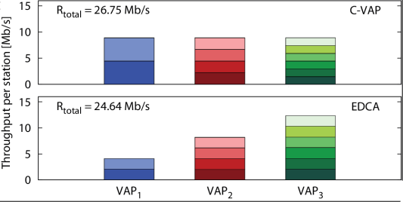
Wireless SDN
Re-purposing commodity 802.11 devices:
Run different MAC protocols on top of modified Firmware
Enable service customisation (premium vs best-effort medium access), more flexible resource sharing
Examples:
Wi-Fi AP virtualisation (fair capacity slicing independent of #users/operator) [1]
Time control, TDMA/CSMA isolation
(hard QoS guarantees) [2]
*Developed in the EU-FP7 ICT-FLAVIA Project.
[1] Banchs et al, "Providing Throughput and Fairness Guarantees in Virtualized WLANs through Control Theory“ (MONET, 2012).
[2] Bianchi et al, “MAClets: Active MAC Protocols over Hard-Coded Devices” (CoNEXT, 2012).
Software-defined networking
Myungjin Lee

